Slide 1


OIL PRICE PREDICTION PROJECT
Team 7
Mentors – Karthik Muskula and Dhanyapriya Somasundaram

Slide 2

Team Members
Anmol Dewangan
Gaurang Manjrekar
Harish Kate
Samad Khatri
Shivprasad Jadhav

Slide 3
Business Problem:
With a global trading price of 88$ per barrel, oil prices have hit an all-time high in the last seven years. Due to rise in oil price the economy are getting affected vary badly.
Objective:
Oil is a product that goes completely in a different direction for a single market event as the oil prices are rarely based on real-time data, instead, it is driven by externalities making our attempt to forecast it even more challenging
As the economy will be highly affected by oil prices our model will help to understand the pattern in prices to help the customers and businesses to make smart decisions.

Slide 4
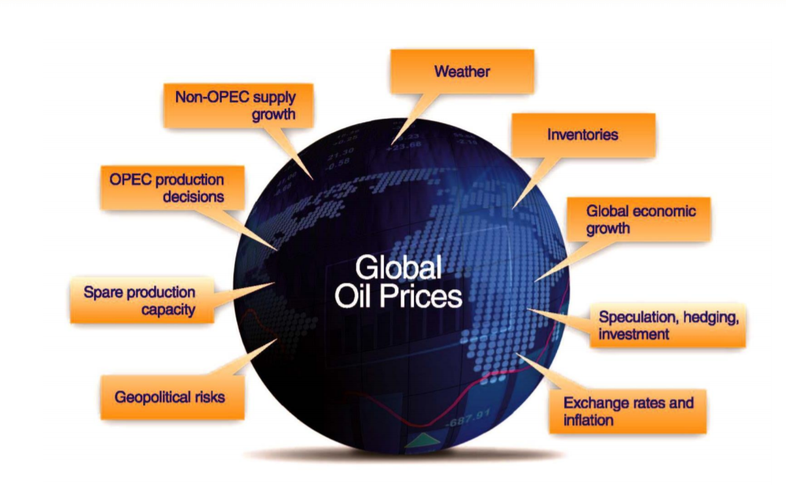
Factors affecting the Oil Prices
Oil Prices get affected by most of the factors , but the one’s that affect the most are demand and supply

Slide 5
Project Architecture / Project Flow
Understanding business problem
Model deployment
Collection of data
Model building
Cleaning of data
Exploratory data analysis

Slide 6
Dataset
Downloaded the Brent oil price dataset from U.S. Energy Information Administration (EIA) website.
Dataset consist of 20th May 1987 to 19th Dec 2022 (36 years) of daily oil price.

Slide 7
Exploratory Data Analysis (EDA)

Slide 8
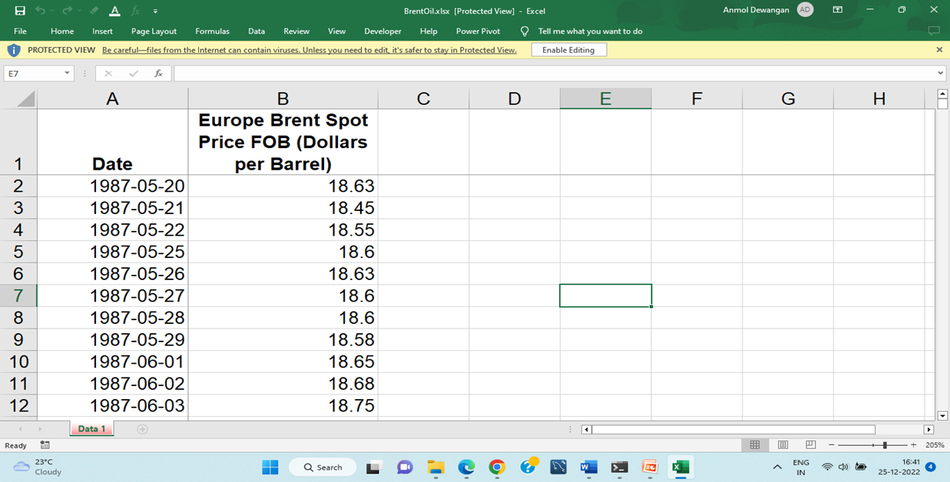
Dataset Details
Dataset
9034 rows and 2 columns
Data Types
Datetime and float
Data Range
from
1987-05-20 to 2022-12-19

Slide 9
Exploratory Data Analysis (EDA)
First, we upload the data
Because we have done already done basic analysis on our data so here we starts from changing the scale of our data from daily basis data to monthly basis data directly
After converting our data into monthly basis it reduces total rows (9034 rows) of data into 428 rows and then we have done pre-processing of monthly data
In the pre processing first we extract Price column form the data set
As we can see the we have total of 428 rows of price data, so we made independent and dependent feature from Price column
Here we made first row by using previous 12 months data from price column as X (independent features) and the next 13 no of price data will become y (dependent variable)
Similarly for the next row we use 2-13 row of price column as X (independent variable) and the next 14 no of row will become y (dependent variable) and so on…..
After creating all the features and rows we have to convert our data from 2-dimension to 3-dimension because LSTM model only works on 3-dimension data set

Slide 10
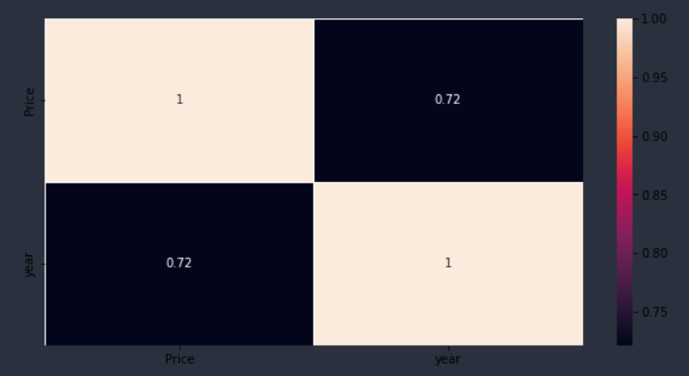
Heat Map
The darker the colour the lesser the value and lightest the colour the highest the value
Inferences:
There is a positive linear correlation between the independent feature ‘Year’ and the dependent feature ‘Price’.

Slide 11
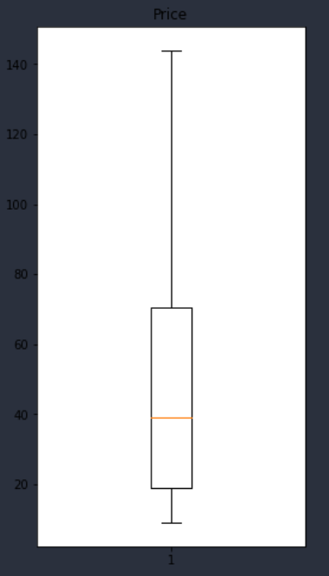
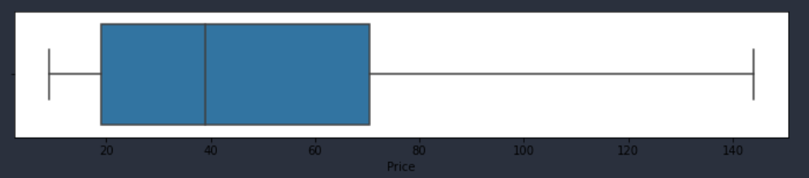
Outlier Detection
Inferences:
There are no outliers above the positive upper extreme whisker.
There are no outliers below the negative side of the lower whisker.
The data looks right skewed which means there are extreme values that do not follow the regular trend of the data.

Slide 12
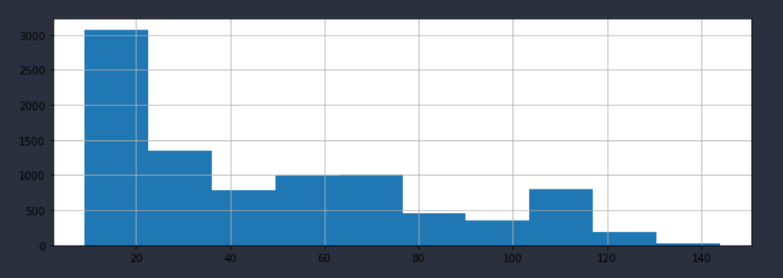
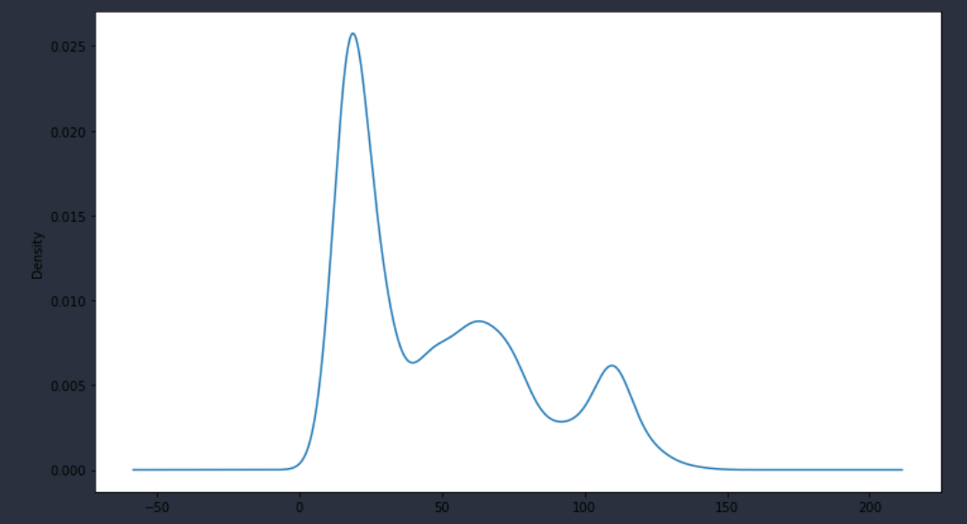
Histogram and Distribution Plot of Brent Oil Prices
Inferences :
Most frequent values of Brent are in the range of 10 to 40.
The Brent oil price values from 50 to 143 are less frequent.
It shows that the data doesn't follow Normal Distribution.
The data is right-skewed.

Slide 13
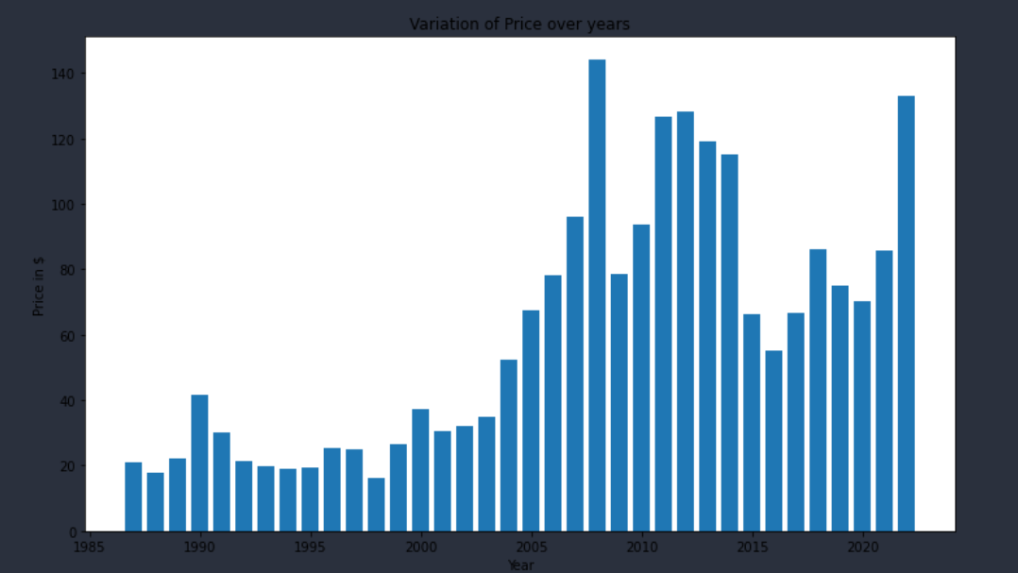
Data Visualization
Bar Plot of Variation of Price over Years

Slide 14
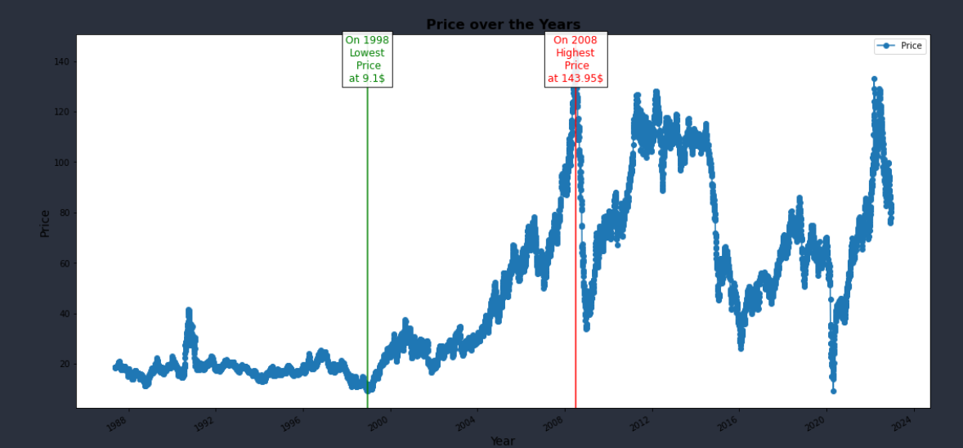
Data Visualization
Inferences :
Trend:
The price was steady increasing till 2008.
The price has dropped significantly in 2010 because of global recession hit.
At the beginning of 2020, oil prices then again declined by due to Covid.
It was observed that after the drop, towards the beginning of 2021 price started to climb.
There is no seasonality but trend is there and the data does not have constant mean and constant variance.
As you can see from the above plot that the lowest price was recorded at 1998 which is 9.1$ and the apex of the price was at 2008 which is 143.95$.

Slide 15
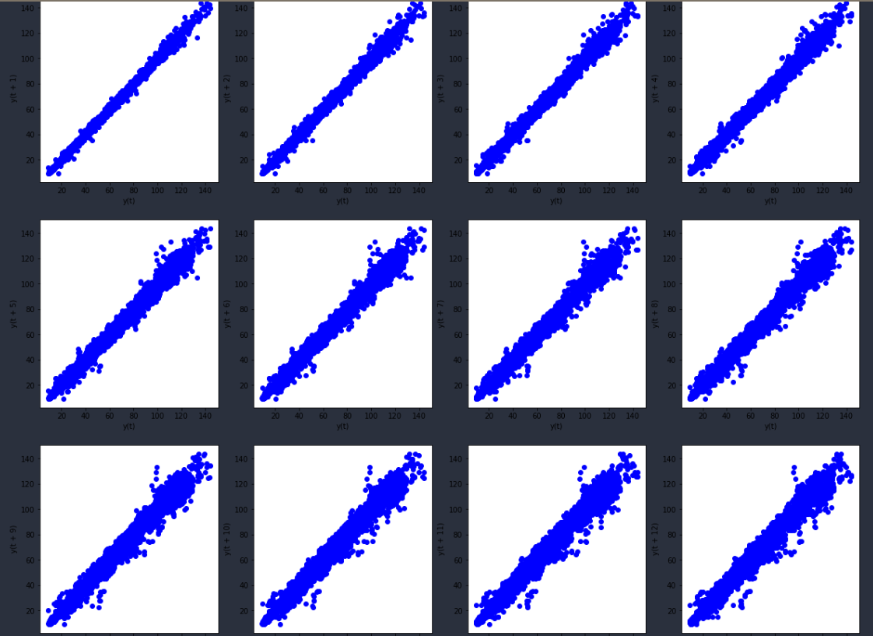
Data Visualization
Lag plots (yearly)
A lag plot is a special type of scatter plot in which the X-axis represents the dataset with some time units behind or ahead as compared to the Y-axis. The difference between these time units is called lag or lagged and it is represented by k.
Inferences: Our data is linear mostly linear and it shows positive autocorrelation with the previous lag values and it has an underlying structure of and autoregressive model.

Slide 16
Model Building

Slide 17
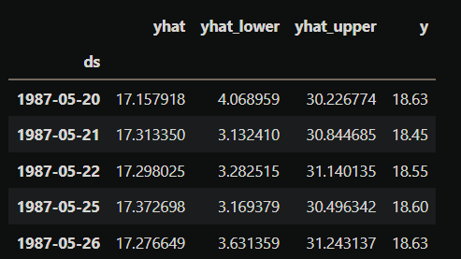
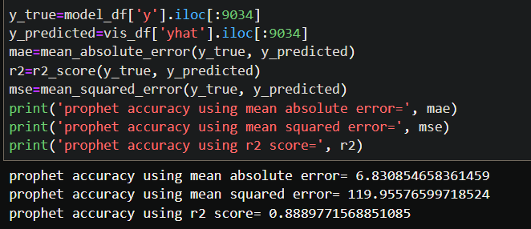
Prophet Model on daily data

Slide 18
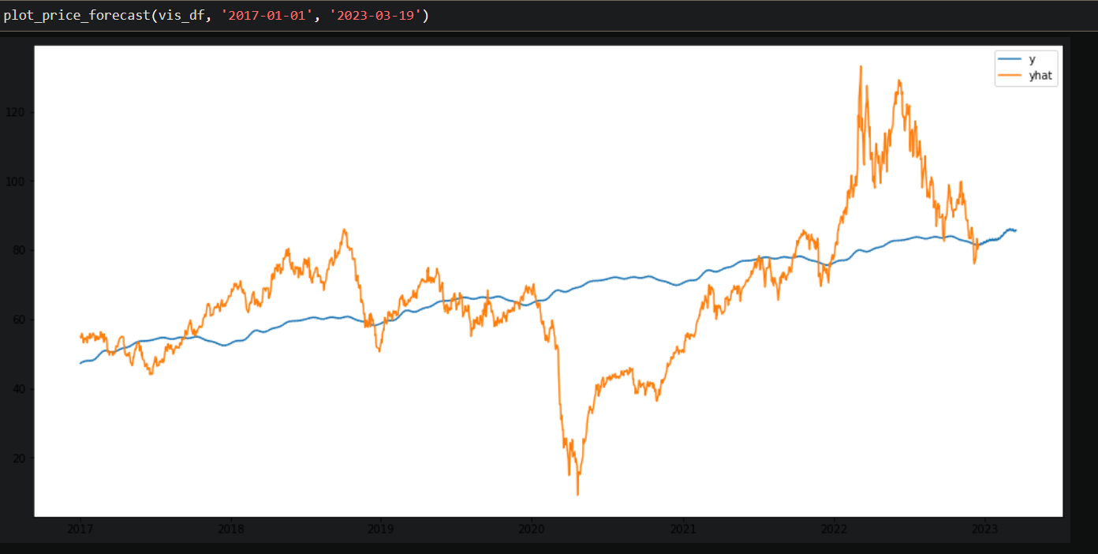
Model Visualization
Forecasting Oil Prices from 2017-01-01 to 2023-03-19

Slide 19
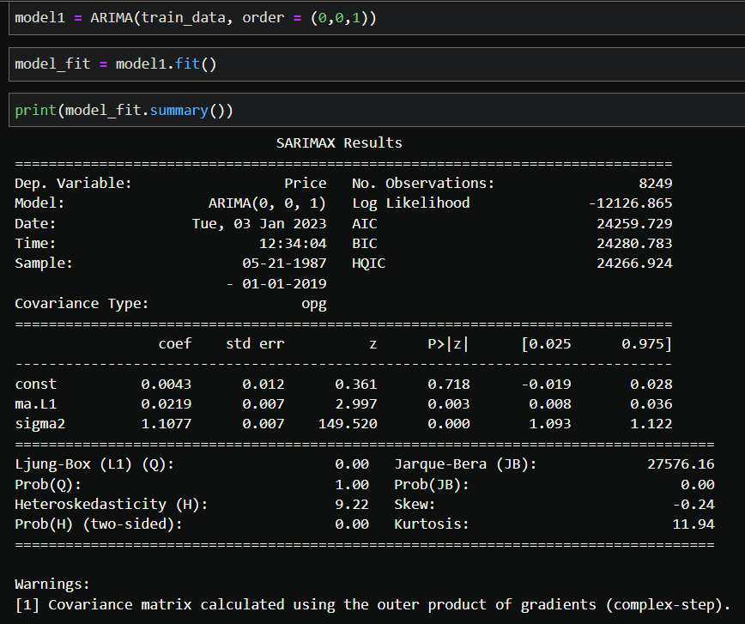
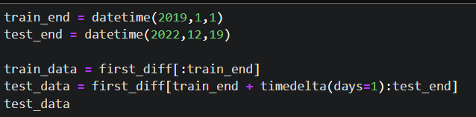
ARIMA Model
Splitting the data into train and test
Train data = 1987-05-20 to 2019-01-01
Test data = 2019-01-02 to 2022-12-19
Model with order = (0, 0, 1)

Slide 20
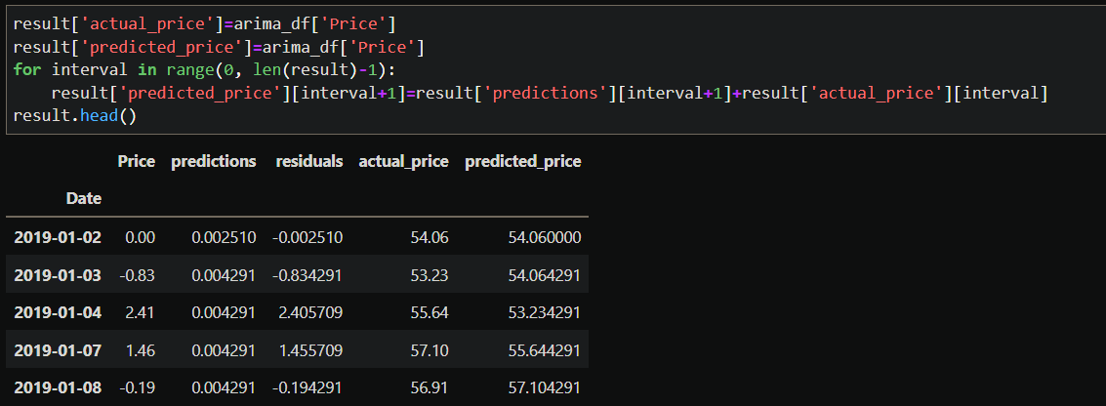
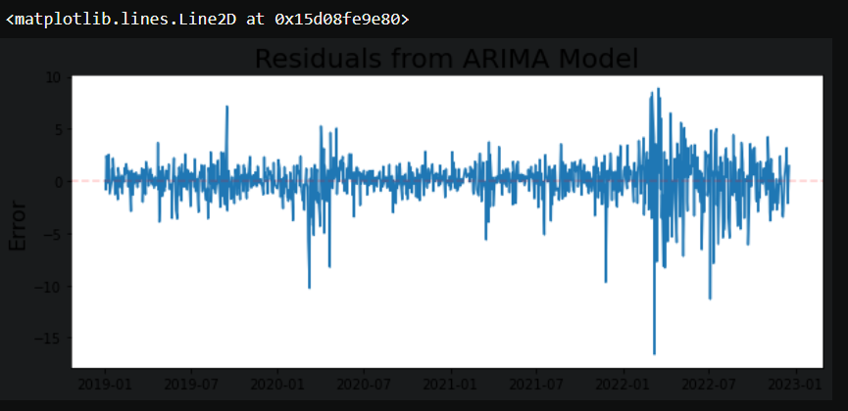
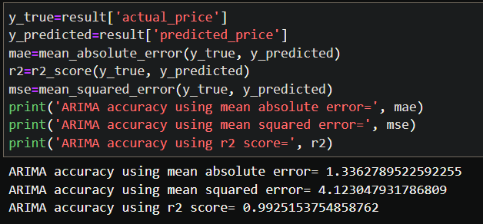
Actual and Predicted prices of models

Slide 21
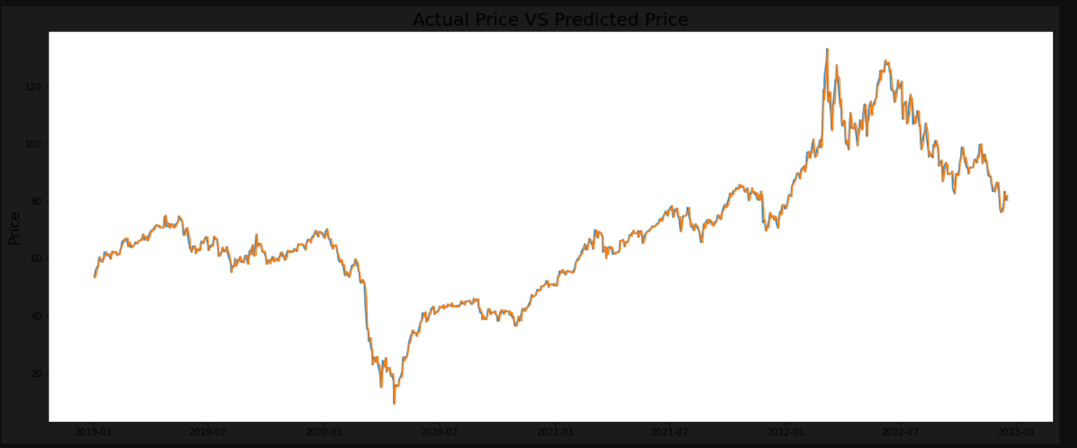
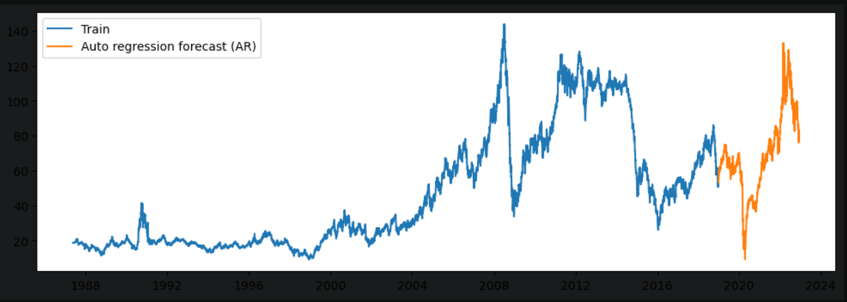
Model Visualization

Slide 22
Model results presentation
Long short-term memory
Model - LSTM
Long short-term memory can be used to model univariate time series forecasting problems. These are problems comprised of a single series of observations and a model is required to learn from the series of past observations to predict the next value in the sequence.
Data set = 9034 rows and 2 columns
Data Range from 1987-05-20 to 2022-12-19

Slide 23
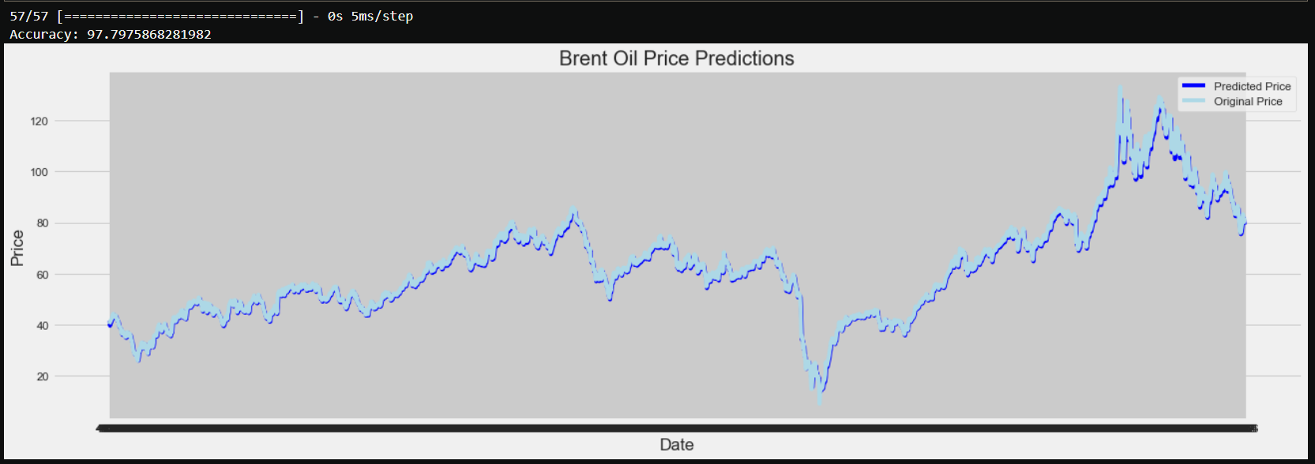
Model Predictions

Slide 24
Model Deployment using Streamlit
Prophet Model

Slide 25
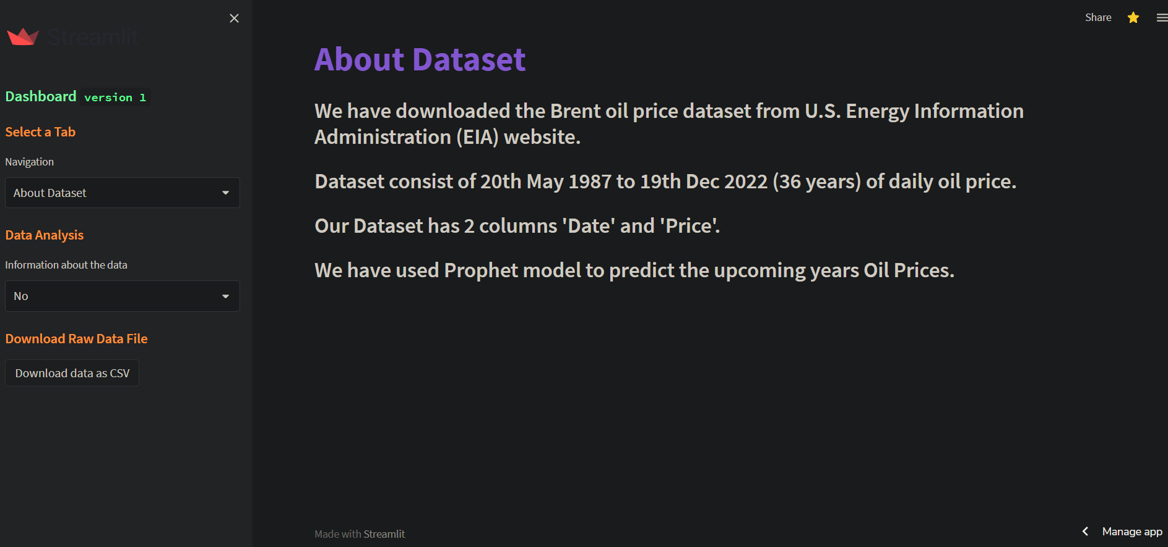

Slide 26
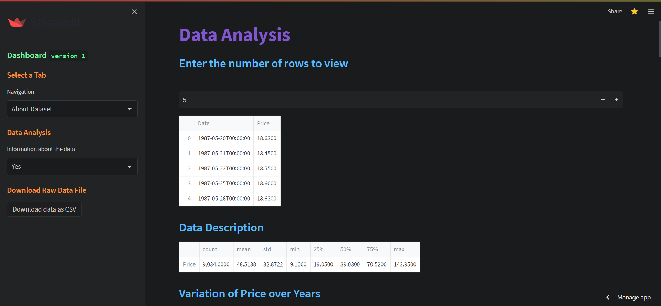

Slide 27
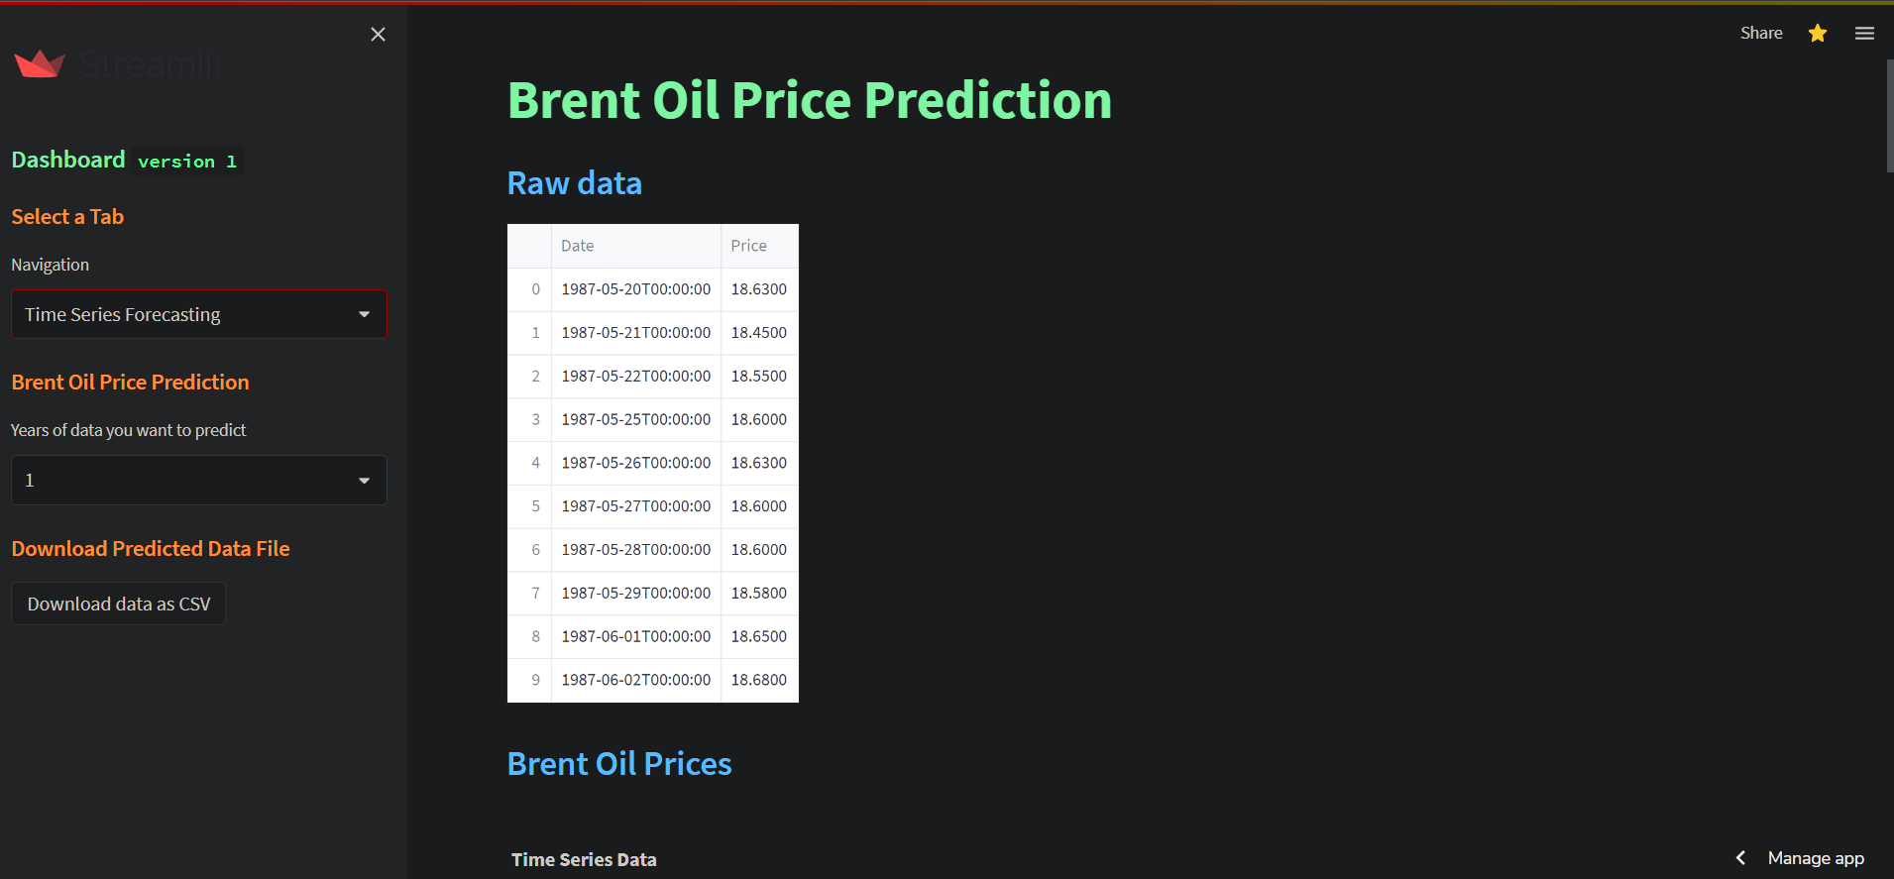

Slide 28
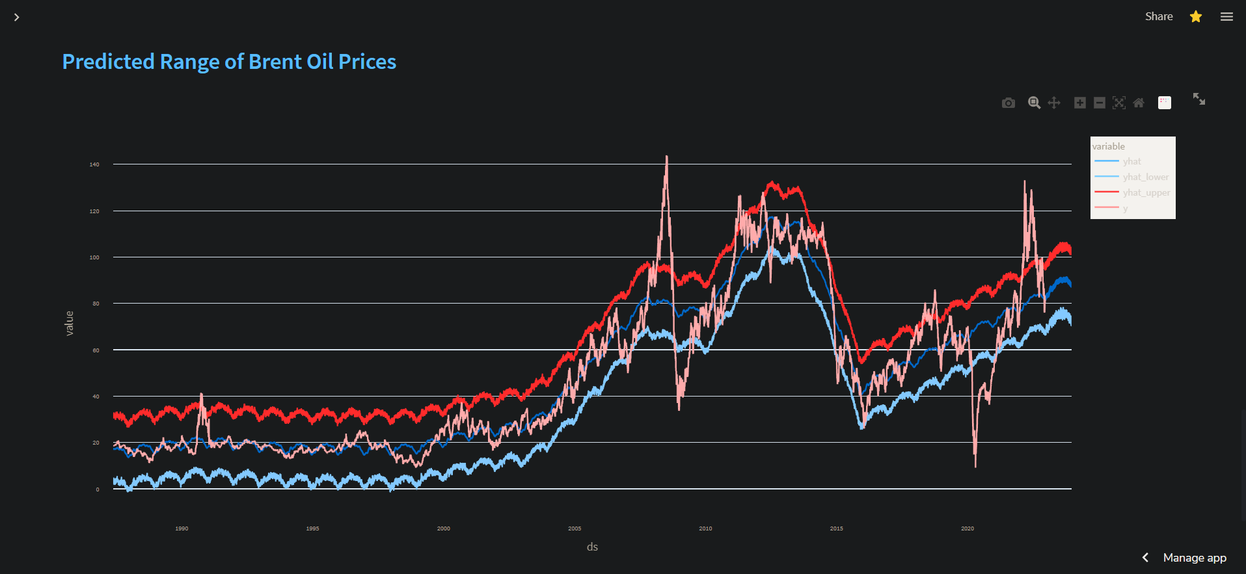
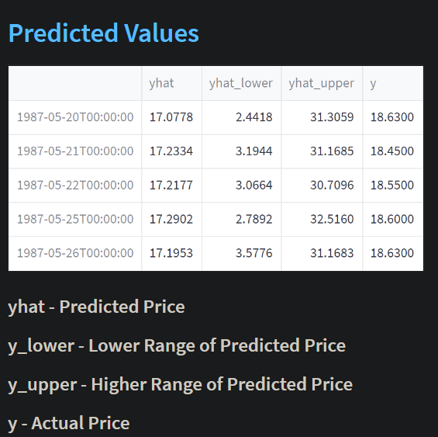
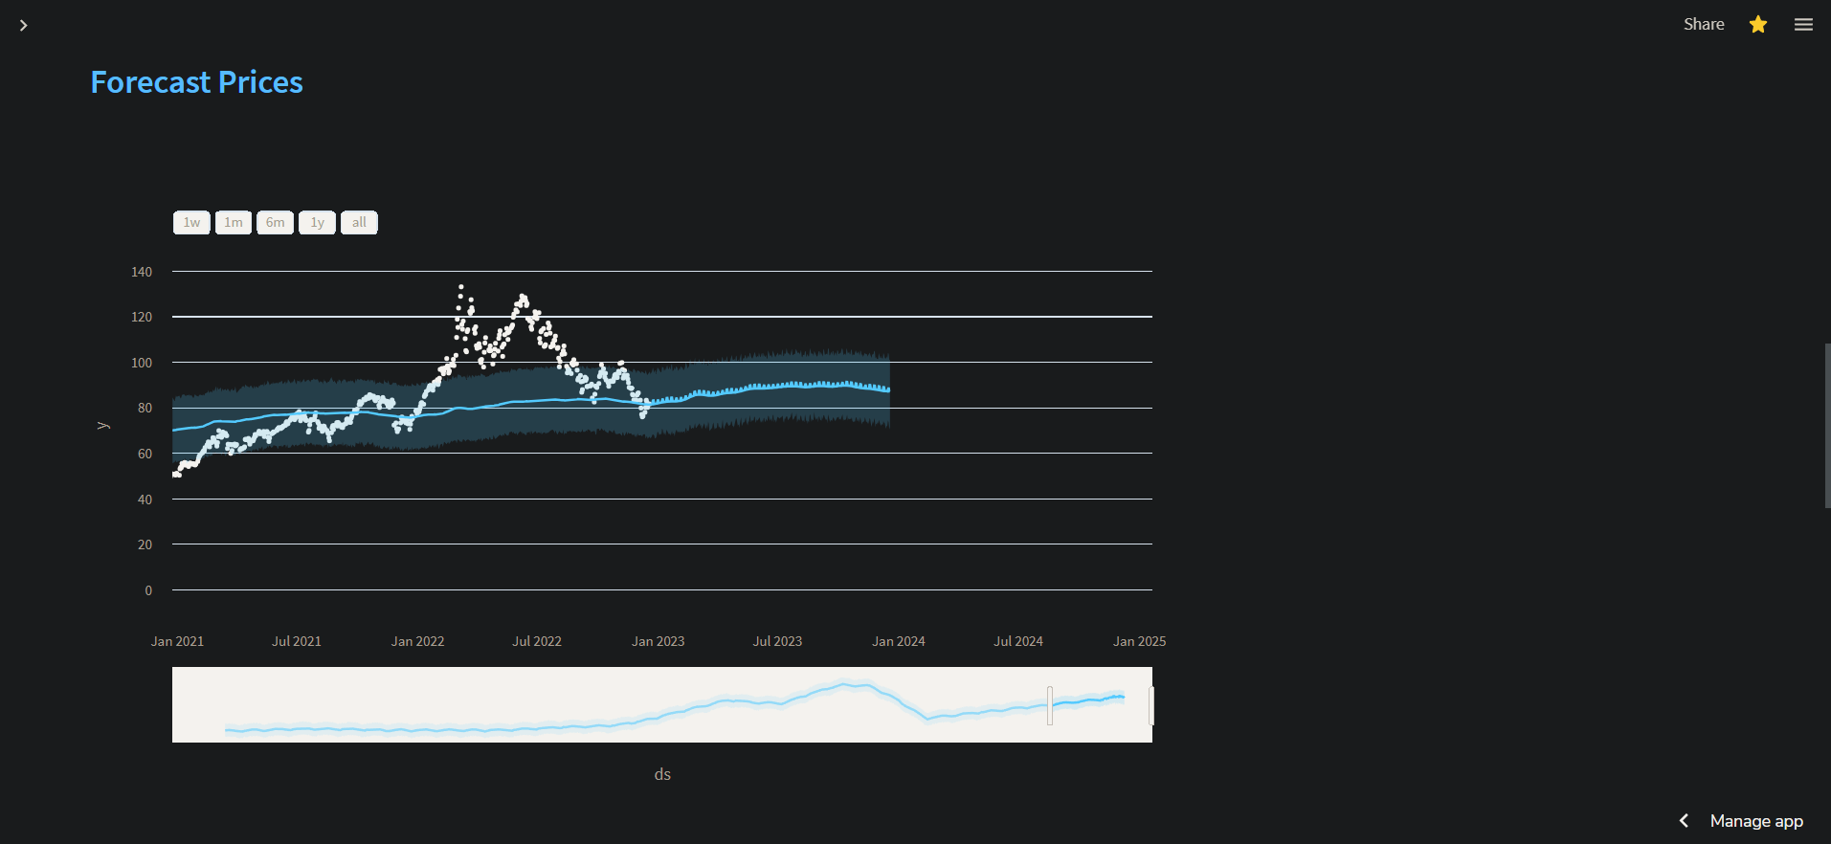
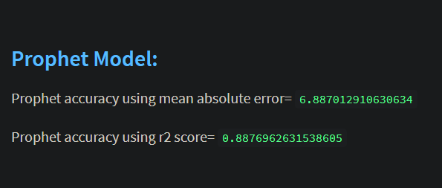

Slide 29
Challenges faced?
The data is positive skewed and doesn't follow normal distribution.
The time series doesn’t have a linear trend.
The time series doesn’t have additive or multiplicative seasonality.
The time series data has high fluctuation and randomness, there is no gradual increase or any repeatable pattern.
Irregularity in time series in which random variations are not purely with respect to time but due to other factors, which could be pandemic, wars, recession, etc. which influences in high fluctuation of the oil prices.
ARIMA Model- Since the time-series data was not stationary we tried differencing method to build model. After the building the model we got an r2 score of 99% i.e. the model got overfitted.
LSTM Model – Just like ARIMA Model this model also got overfitted with an r2 score of more than 97%, and the forecasting price of LSTM model was also not very stable.
.

Slide 30
How did you overcome?
Prophet Model –
1. Accurate and fast - Prophet is accurate and fast. It is used in many applications across Facebook for producing reliable forecasts for planning and goal setting.
2. Fully automatic - Prophet is fully automatic. We will get a reasonable forecast on messy data with no manual effort.
3. Tunable forecasts - Prophet produces adjustable forecasts. It includes many possibilities for users to tweak and adjust forecasts. We can use human-interpretable parameters to improve the forecast by adding our domain knowledge.
4. Robust to outliers - It is robust to outliers. It handles outliers by removing them.
5. Robust to missing data - Prophet is resilient to missing data.
After using Prophet Model we got an accuracy score of 88% and also the forecasted data is stable and is following the actual trend of data.

Slide 31
Thank you

